Slide 1
Substance Abuse
Automate It
Team 630

Slide 2


Database Hierarchy
RDB
Login Credentials
Admin
C
Doctors Table
Insurance Contracts
Insurance Company Table
Doctor Metadata
Login Credentials
Patient Records
Patient Table
C
Company 1
Company 2
Company 3
MC
Patient Metadata Table
Doctors
Patients
Login Credentials
Patient Medication Table
Patient Log Journals Table
Reminders
Pre Admission Tasks
Medication

Slide 3
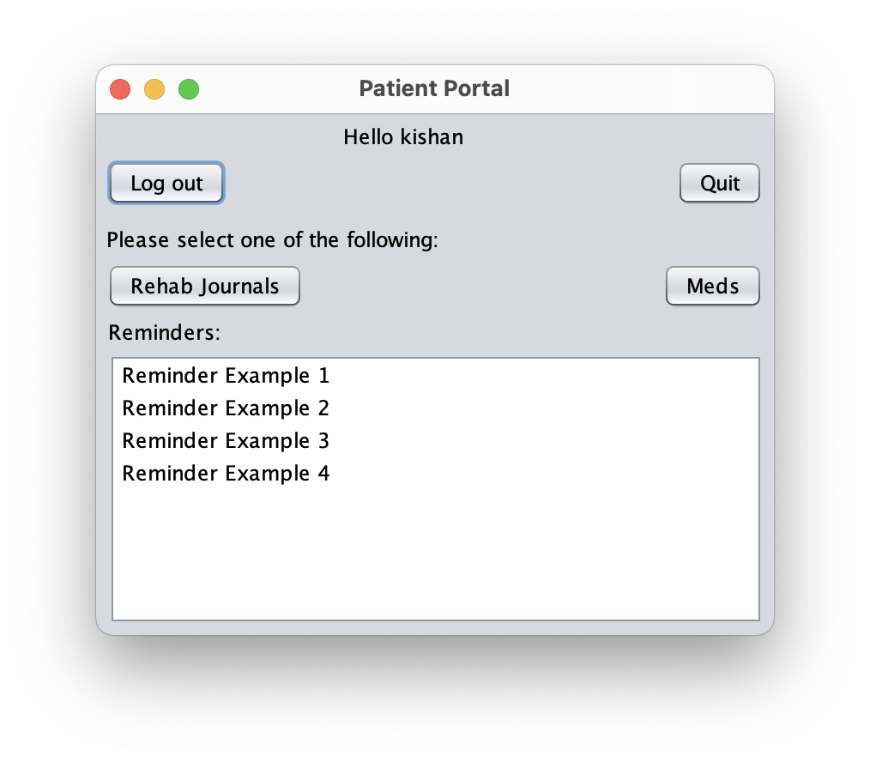
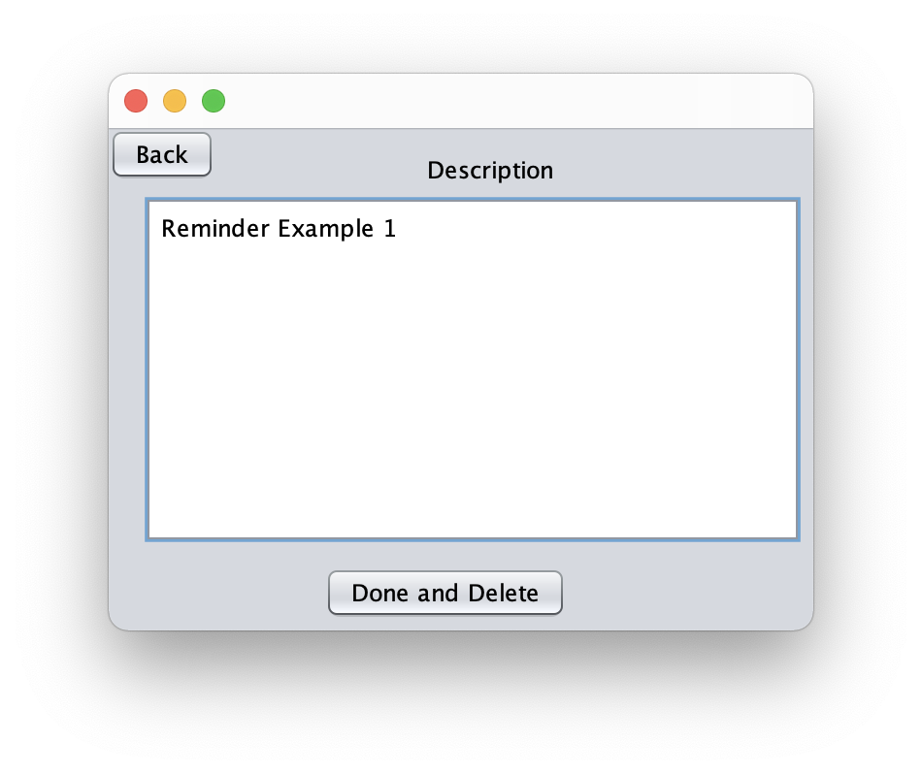
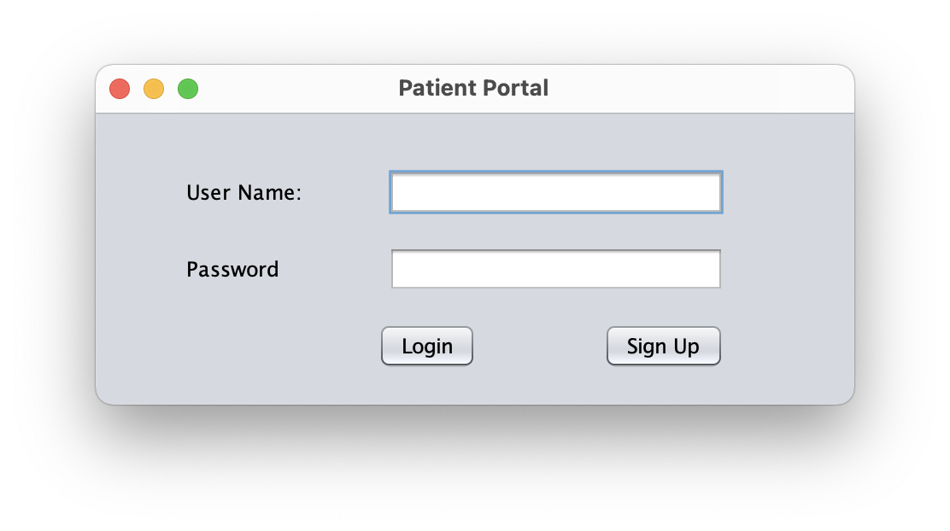
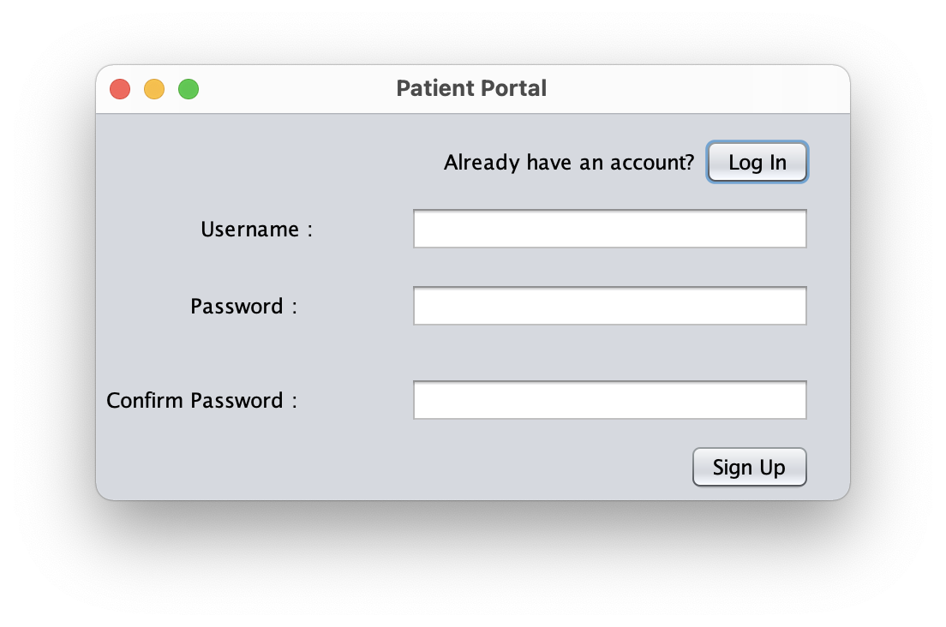
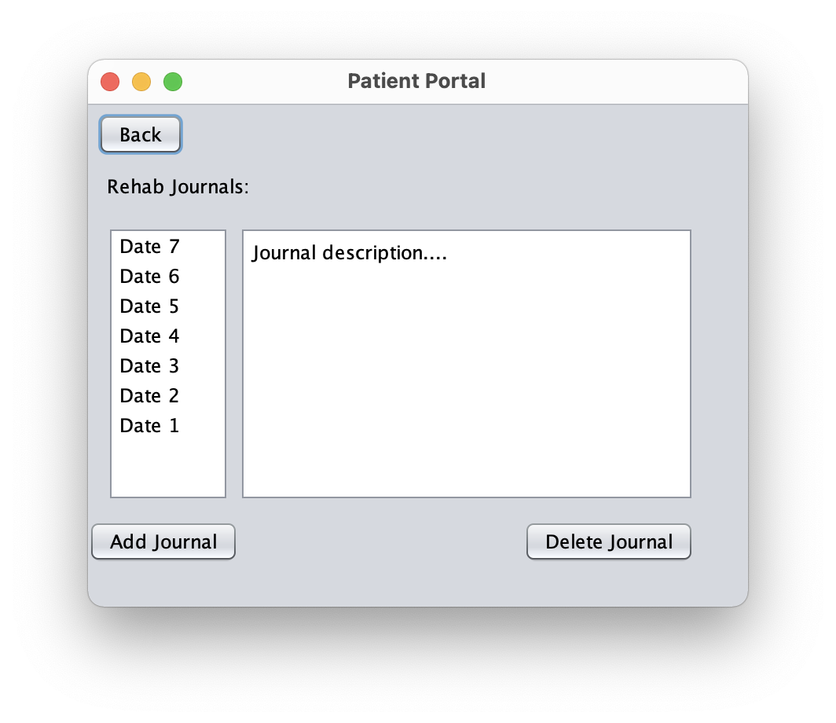
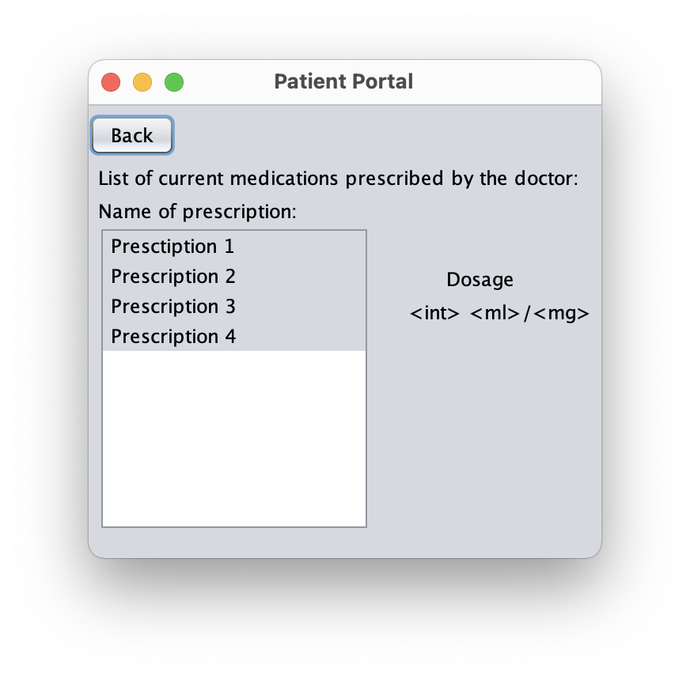
Patient’s App

Slide 4
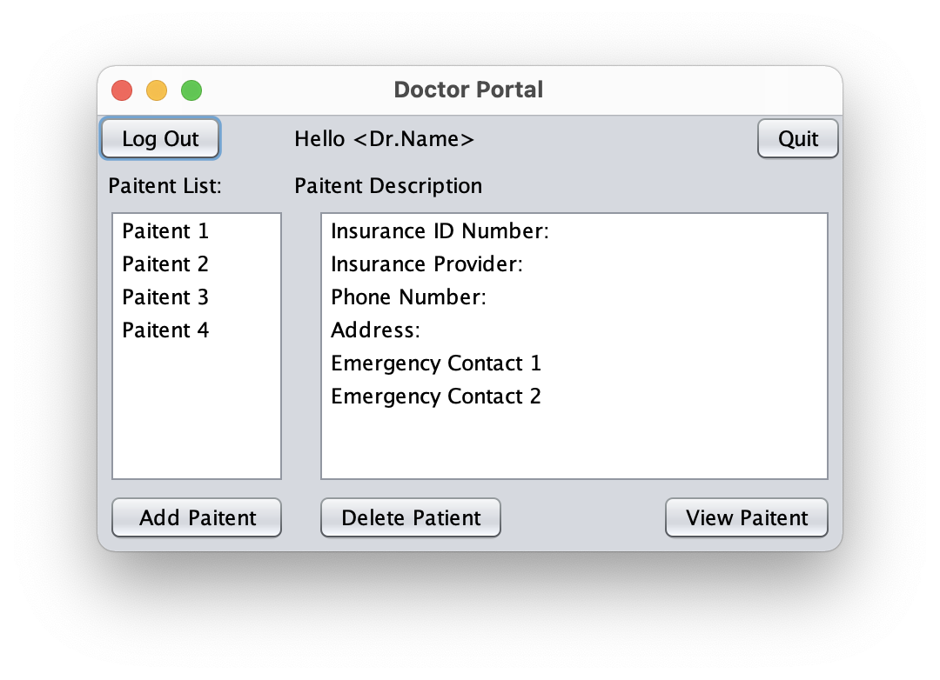
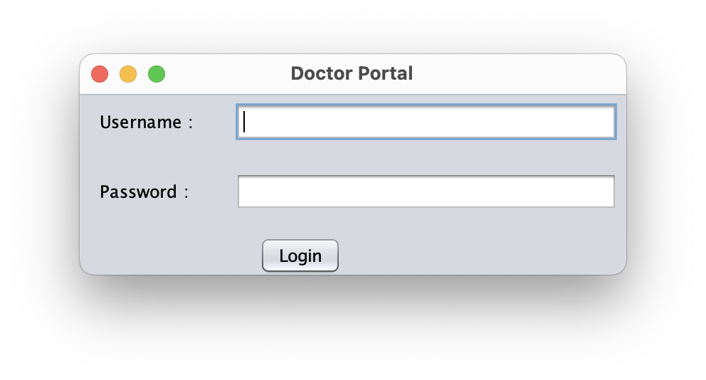
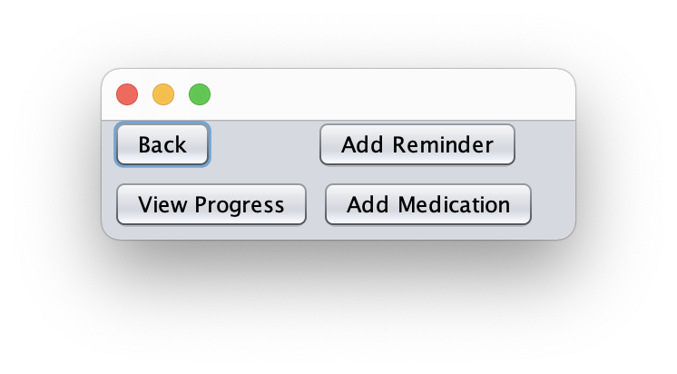
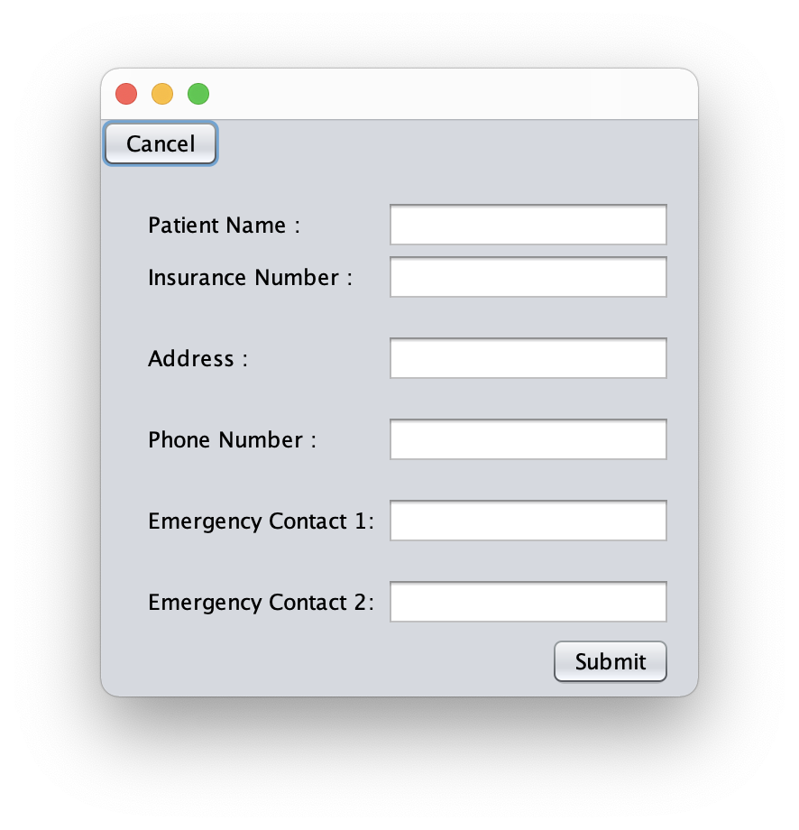
Doctor’s App
Add Medication of the Patient
Automatic reminder
Add reminders and
pre-check in tasks
Access Patient Rehab Journal
Automated task which will be
directly sent back to the doctor
once its completed on the
patient’s app.

Slide 5
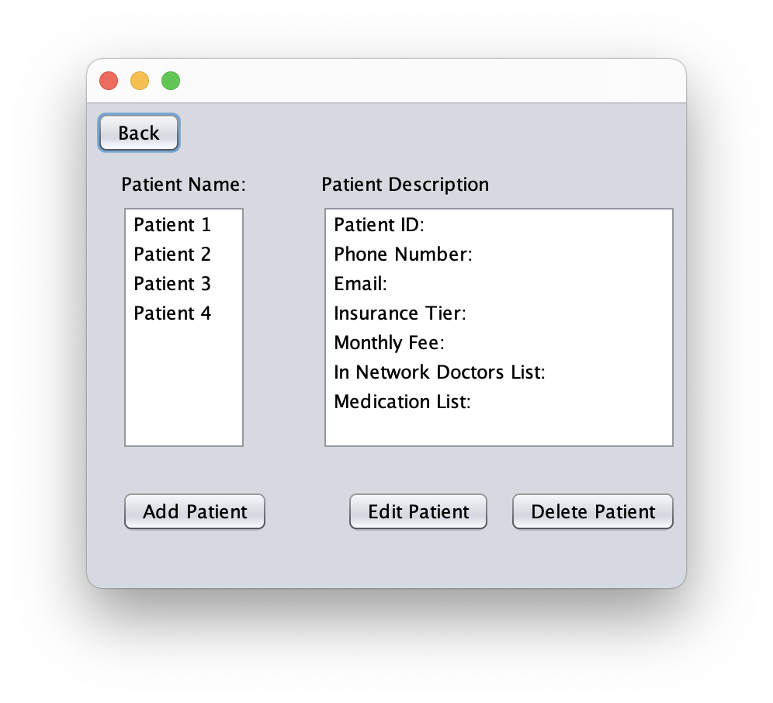
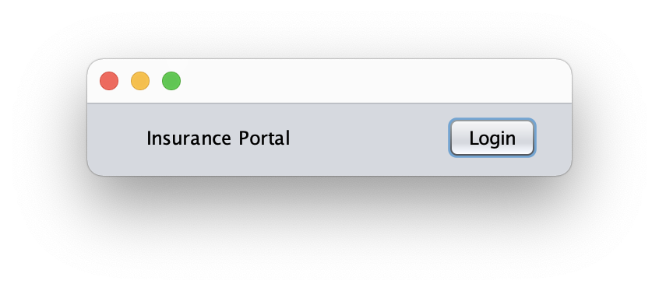
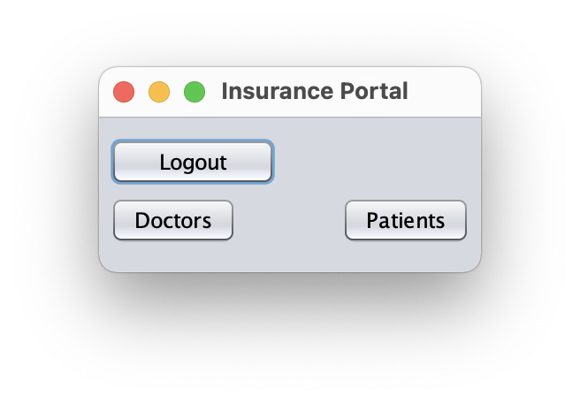
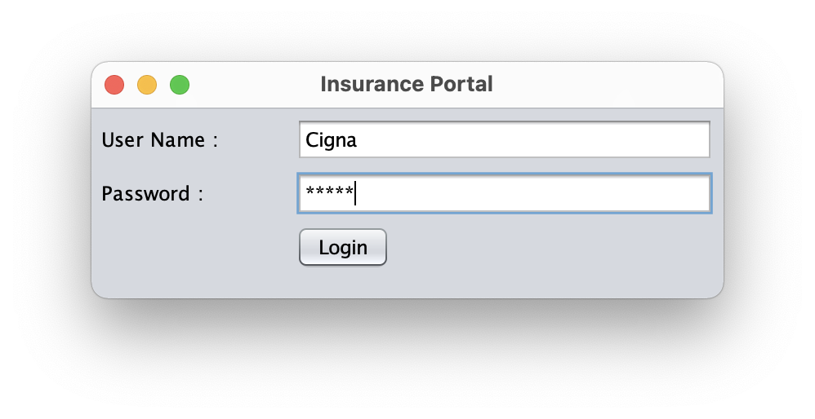
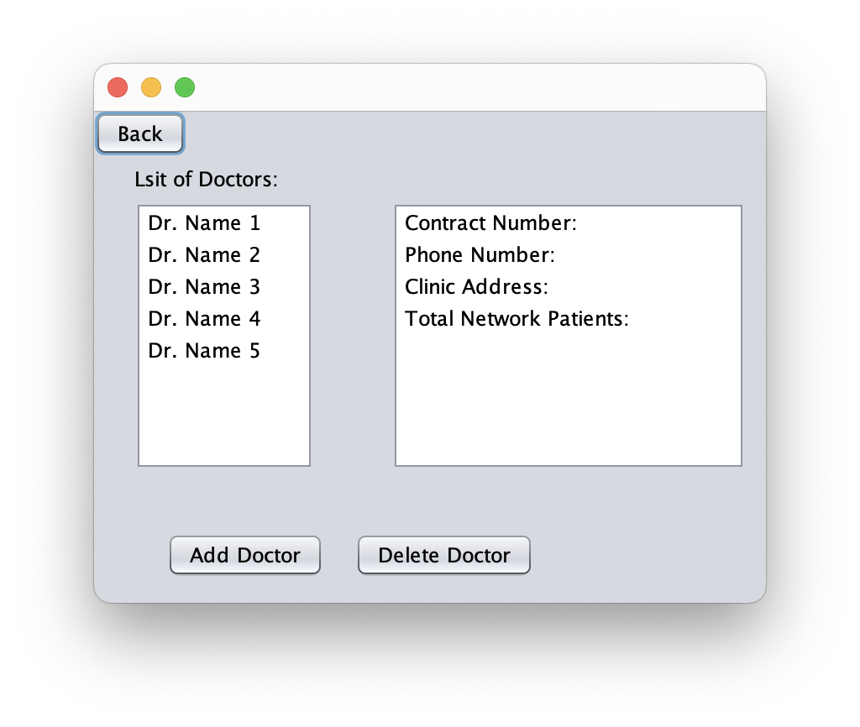
Insurance’s App
Add patient and
patient metadata
Metadata automatically updates
as doctors and medication is added
on both doctor’s and patient’s App
Add doctor and
doctor metadata

Slide 6
Thank You
Ammentorp, Max
Bhakta, Kishan
Lanctot, Joshua
Pathapati, Venkat
Schall, Michael

